Slide 1

9
DIFFERENTIAL EQUATIONS

Slide 2
DIFFERENTIAL EQUATIONS
We have looked at a variety of models for the growth of a single species that lives alone in an environment.

Slide 3
DIFFERENTIAL EQUATIONS
9.6
Predator-Prey Systems
In this section, we will learn about:
Models that take into account the interaction
of two species in the same habitat.

Slide 4
PREDATOR-PREY SYSTEMS
We will see that these models take
the form of a pair of linked differential equations.

Slide 5
PREDATOR-PREY SYSTEMS
We first consider the following situation.
  One species, the prey, has an ample food supply.
  The second, the predator, feeds on the prey.

Slide 6
PREDATOR-PREY SYSTEMS
Examples of prey and predators
include:
  Rabbits and wolves in an isolated forest
  Food fish and sharks
  Aphids and ladybugs
  Bacteria and amoebas

Slide 7
PREDATOR-PREY SYSTEMS
Our model will have two dependent variables, and both are functions of time.
We let R(t) be the number of prey (R for rabbits) and W(t) be the number of predators (W for wolves) at time t.

Slide 8
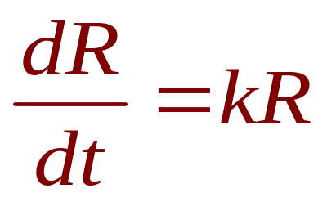
ABSENCE OF PREDATORS
In the absence of predators, the ample food supply would support exponential growth of the prey, that is,
where k is a positive constant.

Slide 9
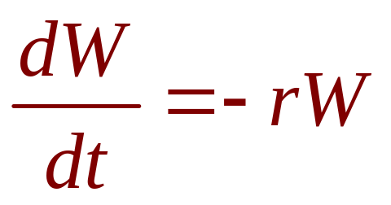
ABSENCE OF PREY
In the absence of prey, we assume that
the predator population would decline at
a rate proportional to itself, that is,
where r is a positive constant.

Slide 10
PREDATOR-PREY SYSTEMS
With both species present, we assume that:
  The principal cause of death among the prey
  is being eaten by a predator.
  The birth and survival rates of the predators depend
  on their available food supply—namely, the prey.

Slide 11
PREDATOR-PREY SYSTEMS
We also assume that the two species encounter each other at a rate that is proportional to both populations and is, therefore, proportional to the product RW.
  The more there are of either population,
  the more encounters there are likely to be.

Slide 12
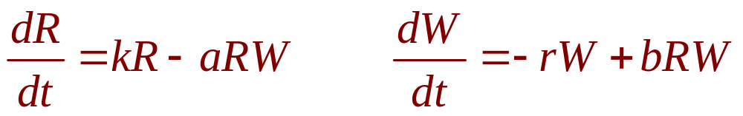
PREDATOR-PREY SYSTEMS
Equation 1
A system of two differential equations that incorporates these assumptions is
where k, r, a, and b are positive constants.

Slide 13
PREDATOR-PREY SYSTEMS
Notice that:
  The term –aRW decreases the natural
  growth rate of the prey.
  The term bRW increases the natural
  growth rate of the predators.

Slide 14
LOTKA-VOLTERRA EQUATIONS
The equations in (1) are known
as the predator-prey equations,
or the Lotka-Volterra equations.
  They were proposed as a model to explain
  the variations in the shark and food-fish populations
  in the Adriatic Sea by the Italian mathematician
  Vito Volterra (1860–1940).

Slide 15
PREDATOR-PREY SYSTEMS
A solution of this system of equations is
a pair of functions R(t) and W(t) that describe the populations of prey and predator as functions of time.
  As the system is coupled (R and W occur
  in both equations), we can’t solve one equation
  and then the other.
  We have to solve them simultaneously.

Slide 16
PREDATOR-PREY SYSTEMS
Unfortunately, it is usually impossible
to find explicit formulas for R and W as functions of t.
  However, we can use graphical methods
  to analyze the equations.

Slide 17
PREDATOR-PREY SYSTEMS
Example 1
Suppose that populations of rabbits and wolves are described by the Lotka-Volterra equations with:
k = 0.08, a = 0.001, r = 0.02, b = 0.00002
The time t is measured in months.

Slide 18
PREDATOR-PREY SYSTEMS
Example 1
Find the constant solutions (called
the equilibrium solutions) and interpret
the answer.
Use the system of differential equations
to find an expression for dW/dR.

Slide 19
PREDATOR-PREY SYSTEMS
Example 1
Draw a direction field for the resulting differential equation in the RW-plane.
Then, use that direction field to sketch
some solution curves.

Slide 20
PREDATOR-PREY SYSTEMS
Example 1
Suppose that, at some point in time,
there are 1000 rabbits and 40 wolves.
Draw the corresponding solution curve
and use it to describe the changes in both population levels.
Use (d) to make sketches of R and W
as functions of t.

Slide 21
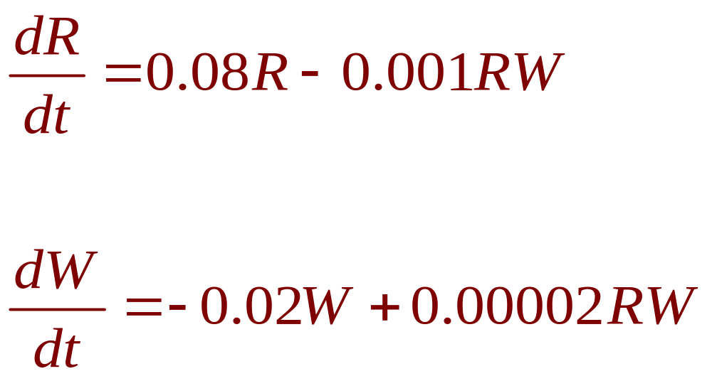
PREDATOR-PREY SYSTEMS
Example 1 a
With the given values of k, a, r, and b,
the Lotka-Volterra equations become:

Slide 22
PREDATOR-PREY SYSTEMS
Example 1 a
Both R and W will be constant if both derivatives are 0.
That is,
R’ = R(0.08 – 0.001W) = 0
W’ = W(– 0.02 + 0.00002R) = 0

Slide 23
PREDATOR-PREY SYSTEMS
Example 1 a
One solution is given by:
R = 0 and W = 0
  This makes sense.
  If there are no rabbits or wolves, the populations
  are certainly not going to increase.

Slide 24
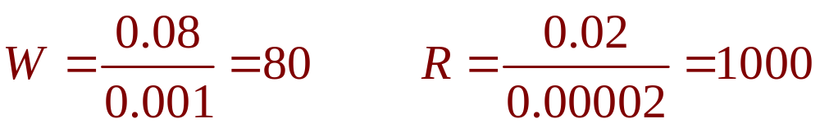
PREDATOR-PREY SYSTEMS
Example 1 a
The other constant solution is:
  So, the equilibrium populations consist
  of 80 wolves and 1000 rabbits.

Slide 25
PREDATOR-PREY SYSTEMS
Example 1 a
This means that 1000 rabbits are
just enough to support a constant wolf population of 80.
  The wolves aren’t too many—which would result
  in fewer rabbits.
  They aren’t too few—which would result in more
  rabbits.

Slide 26
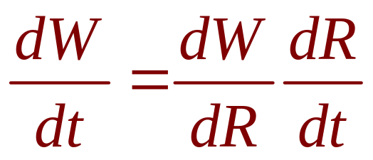
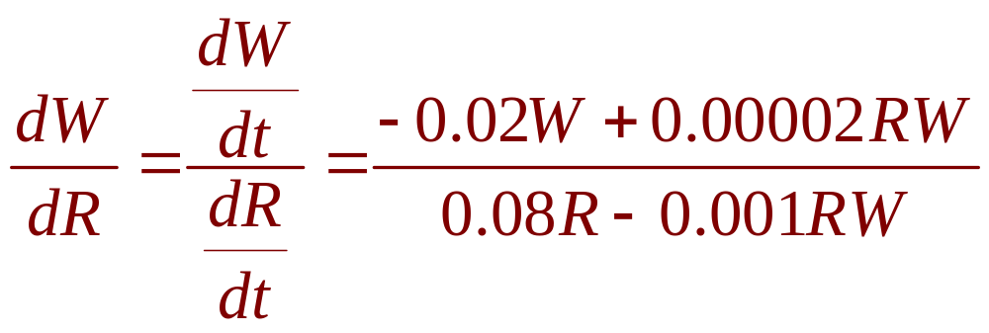
PREDATOR-PREY SYSTEMS
Example 1 b
We use the Chain Rule
to eliminate t :
Hence,

Slide 27
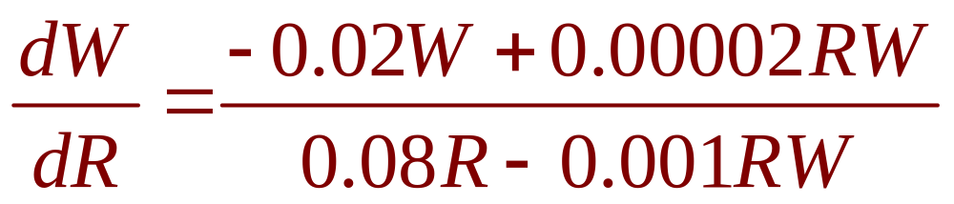
PREDATOR-PREY SYSTEMS
Example 1 c
If we think of W as a function of R,
we have the differential equation

Slide 28
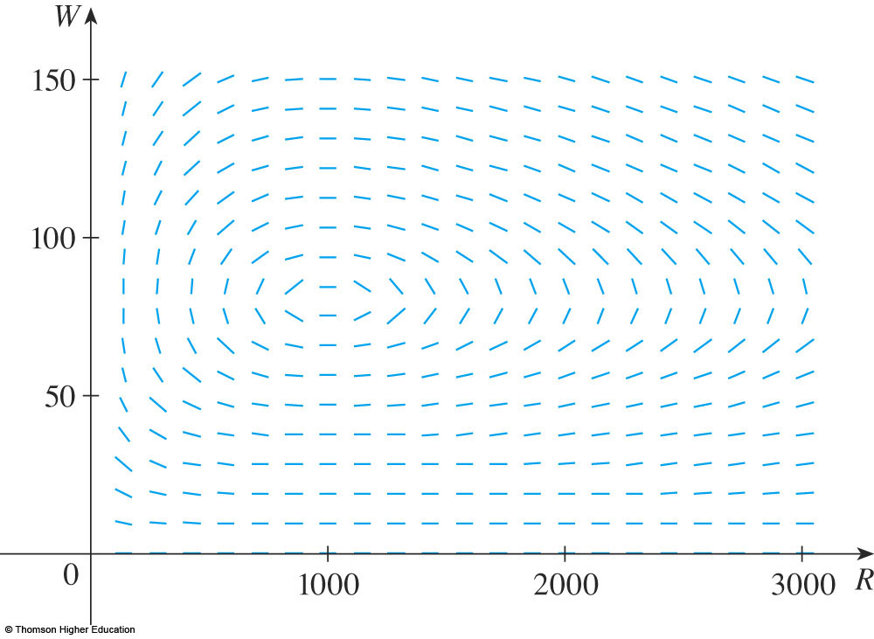
PREDATOR-PREY SYSTEMS
Example 1 c
We draw the direction field for
the differential equation.

Slide 29
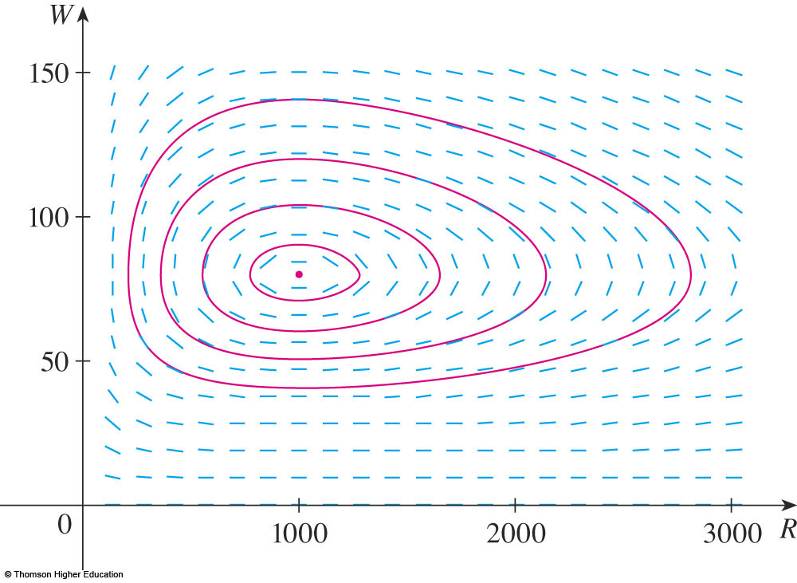
PREDATOR-PREY SYSTEMS
Example 1 c
Then, we use the field to sketch several solution curves.

Slide 30
PREDATOR-PREY SYSTEMS
Example 1 c
If we move along a solution curve, we
observe how the relationship between R
and W changes as time passes.

Slide 31
PREDATOR-PREY SYSTEMS
Example 1 c
Notice that the curves appear to be closed
in the sense that, if we travel along a curve, we always return to the same point.

Slide 32
EQUILIBRIUM POINT
Example 1 c
Notice also that the point (1000, 80) is inside all the solution curves.
  It is called an equilibrium point.
  It corresponds to the
  equilibrium solution
  R = 1000, W = 80.

Slide 33
PHASE PLANE
Example 1 c
When we represent solutions of a system
of differential equations as here, we refer to the RW-plane as the phase plane.

Slide 34
PHASE TRAJECTORIES
Example 1 c
Then, we call the solution curves phase trajectories.
  So, a phase trajectory
  is a path traced out
  by solutions (R, W)
  as time goes by.

Slide 35
PHASE PORTRAIT
Example 1 c
A phase portrait, as shown,
consists of:
  Equilibrium points
  Typical phase
  trajectories

Slide 36
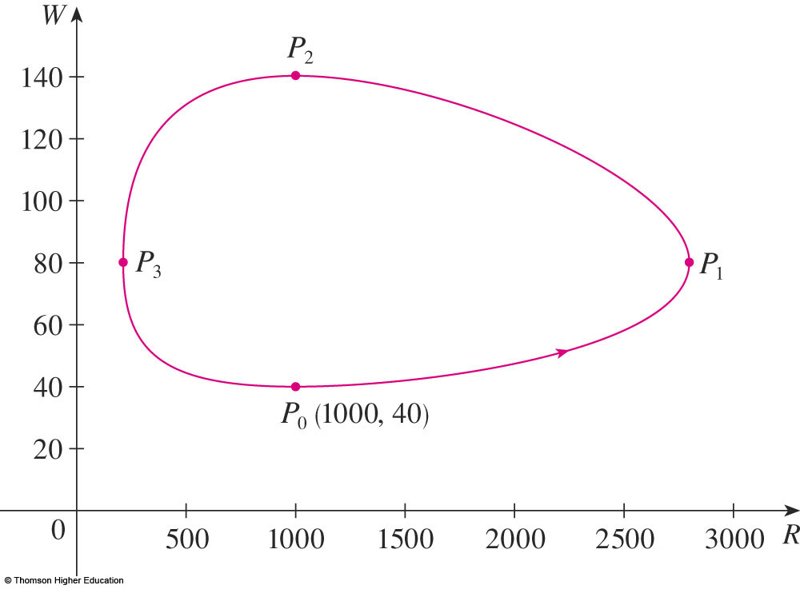
PREDATOR-PREY SYSTEMS
Example 1 d
Starting with 1000 rabbits and 40 wolves corresponds to drawing the solution curve through the point P₀(1000, 40).
  The figure shows
  the phase trajectory
  with the direction
  field removed.

Slide 37
PREDATOR-PREY SYSTEMS
Example 1 d
Starting at the point P₀ at time t = 0
and letting t increase, do we move clockwise
or counterclockwise around the phase trajectory?

Slide 38
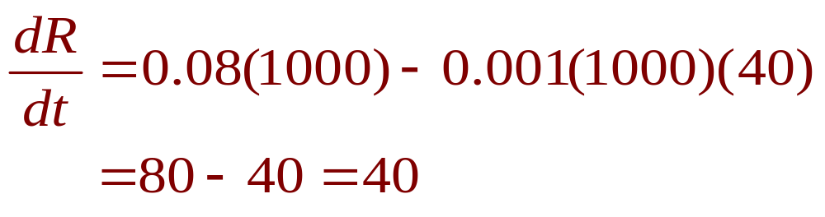
PREDATOR-PREY SYSTEMS
Example 1 d
If we put R = 1000 and W = 40 in the first differential equation, we get:

Slide 39
PREDATOR-PREY SYSTEMS
Example 1 d
Since dR/dt > 0, we conclude that R is increasing at P₀.
So, we move counterclockwise around
the phase trajectory.

Slide 40
PREDATOR-PREY SYSTEMS
Example 1 d
We see that, at P₀, there aren’t enough
wolves to maintain a balance between
the populations.
  So, the rabbit
  population increases.

Slide 41
PREDATOR-PREY SYSTEMS
Example 1 d
That results in more wolves.
  Eventually, there are so many wolves that
  the rabbits have a hard time avoiding them.

Slide 42
PREDATOR-PREY SYSTEMS
Example 1 d
Hence, the number of rabbits begins
to decline.
  This is at P₁, where
  we estimate that R
  reaches its maximum
  population of about
  2800.

Slide 43
PREDATOR-PREY SYSTEMS
Example 1 d
This means that, at some later time,
the wolf population starts to fall.
  This is at P₂, where R = 1000 and W ≈ 140.

Slide 44
PREDATOR-PREY SYSTEMS
Example 1 d
However, this benefits the rabbits.
So, their population later starts to increase.
  This is at P₃, where W = 80 and R ≈ 210.

Slide 45
PREDATOR-PREY SYSTEMS
Example 1 d
Consequently, the wolf population eventually starts to increase as well.
  This happens when
  the populations return
  to their initial values
  (R = 1000, W = 40),
  and the entire cycle
  begins again.

Slide 46
PREDATOR-PREY SYSTEMS
Example 1 e
From the description in (d) of how
the rabbit and wolf populations rise
and fall, we can sketch the graphs of
R(t) and W(t).

Slide 47
PREDATOR-PREY SYSTEMS
Example 1 e
Suppose the points P₁, P₂, and P₃
are reached at times t₁, t₂, and t₃ .

Slide 48
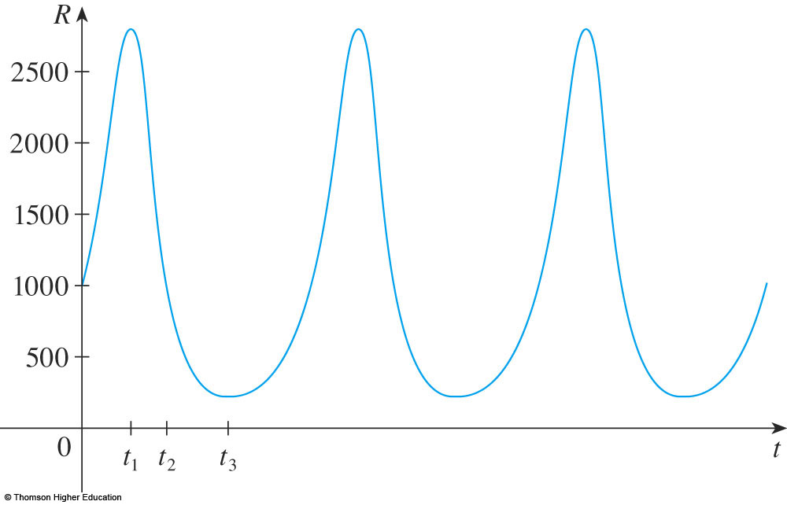
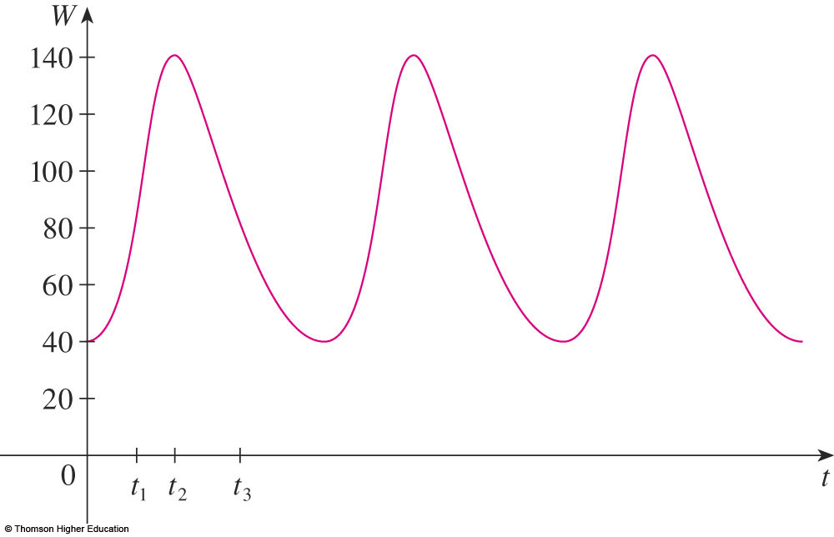
PREDATOR-PREY SYSTEMS
Example 1 e
Then, we can
sketch graphs
of R and W, as
shown.

Slide 49
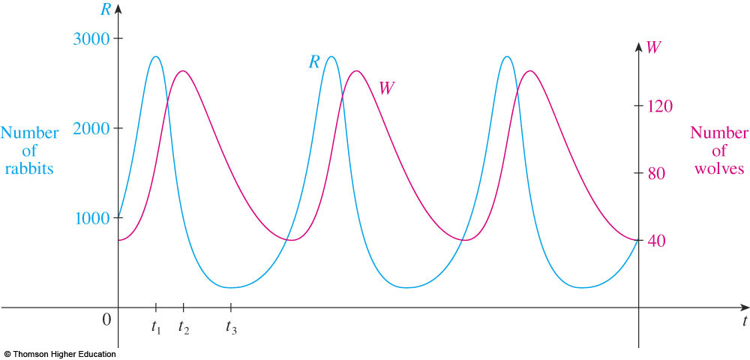
PREDATOR-PREY SYSTEMS
Example 1 e
To make the graphs easier to compare,
we draw them on the same axes, but with different scales for R and W.

Slide 50
PREDATOR-PREY SYSTEMS
Example 1 e
Notice that the rabbits reach their maximum populations about a quarter of a cycle before the wolves.

Slide 51
REAL-WORLD PREDICTIONS
An important part of the modeling process,
as discussed in Section 1.2, is to interpret
our mathematical conclusions as real-world predictions and test them against real data.

Slide 52
REAL-WORLD PREDICTIONS
For instance, the Hudson’s Bay Company, which started trading in animal furs in Canada in 1670, has kept records that date back to
the 1840s.

Slide 53
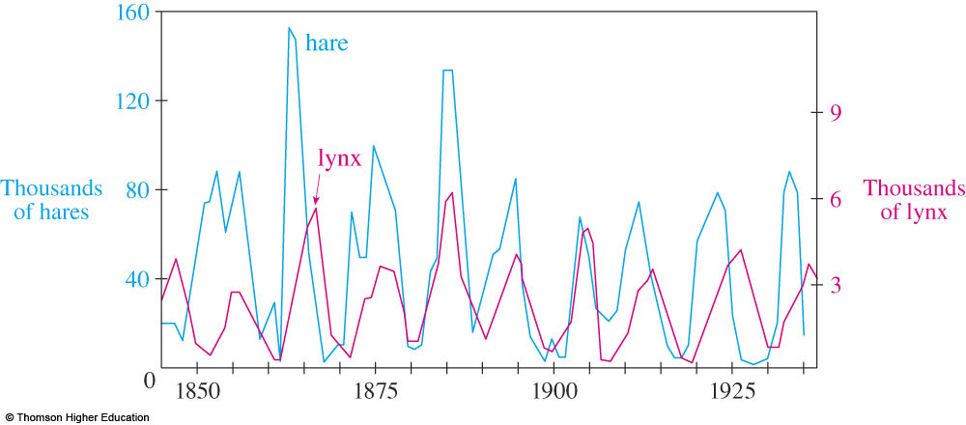
REAL-WORLD PREDICTIONS
The graphs show the number of pelts of
the snowshoe hare and its predator, the Canada lynx, traded over a 90-year period.

Slide 54
REAL-WORLD PREDICTIONS
You can see that the coupled oscillations in
the hare and lynx populations predicted by
the Lotka-Volterra model do actually occur.

Slide 55
REAL-WORLD PREDICTIONS
The period of these cycles is roughly 10 years.

Slide 56
SOPHISTICATED MODELS
Though the relatively simple Lotka-Volterra model has had some success in explaining and predicting coupled populations, more sophisticated models have also been proposed.

Slide 57
MODIFYING LOTKA-VOLTERRA EQUATIONS
One way to possibly modify the Lotka-Volterra equations is to assume that, in the absence
of predators, the prey grow according to
a logistic model with carrying capacity K.

Slide 58
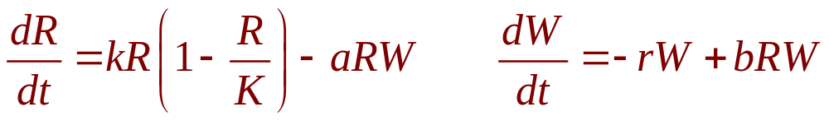
MODIFYING LOTKA-VOLTERRA EQUATIONS
Then, the Lotka-Volterra equations are replaced by the system of differential equations
  This model is investigated in Exercises 9 and 10.

Slide 59
SOPHISTICATED MODELS
Models have also been proposed to
describe and predict population levels of
two species that compete for the same resources or cooperate for mutual benefit.
  Such models are explored in Exercise 2.

